Slide 1
Time series

Slide 2
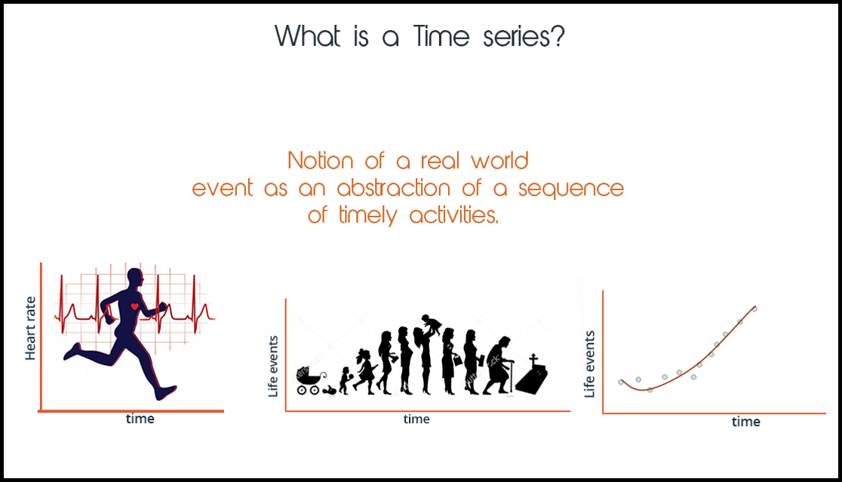

Slide 3
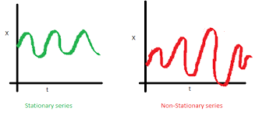

Slide 4
A univariate time series is a sequence of measurements of the same variable collected over time.
Most often, the measurements are made at regular time intervals.

Slide 5
To describe the important features of the time series pattern.
To explain how the past affects the future or how two time series can “interact”.
To forecast future values of the series.
To possibly serve as a control standard for a variable that measures the quality of product in some manufacturing situations.

Slide 6
There are two basic types of “time domain” models.
Models that relate the present value of a series to past values and past prediction errors - these are called ARIMA models (for Autoregressive Integrated Moving Average). We’ll spend substantial time on these.
Ordinary regression models that use time

Slide 7
Is there a trend, meaning that, on average, the measurements tend to increase (or decrease) over time?
Is there seasonality, meaning that there is a regularly repeating pattern of highs and lows related to calendar time such as seasons, quarters, months, days of the week, and so on?
Are their outliers? In regression, outliers are far away from your line. With time series data, your outliers are far away from your other data.
Is there a long-run cycle or period unrelated to seasonality factors?
Is there constant varianceover time, or is the variance non-constant?
Are there any abrupt changes to either the level of the series or the variance?

Slide 8
Autocorrelation Function (ACF)

Slide 9
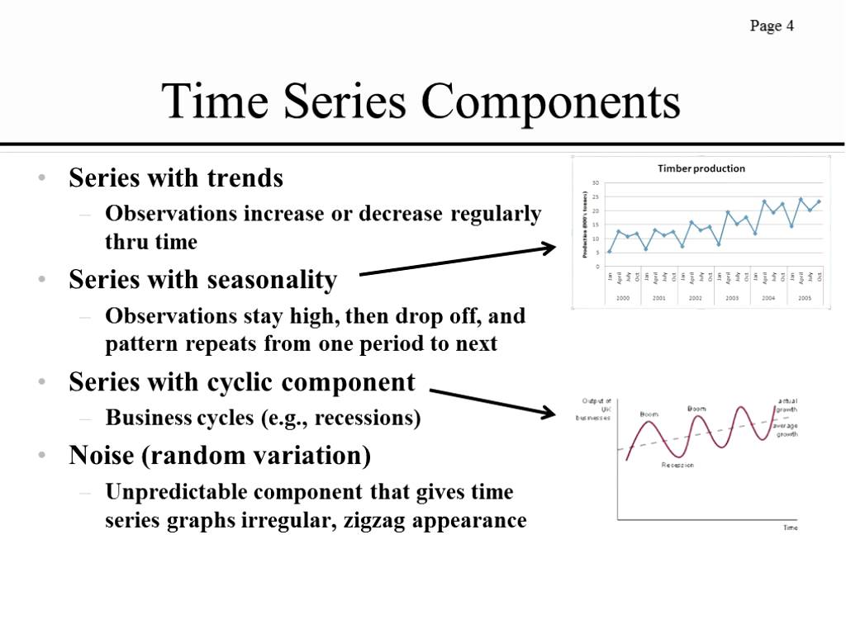

Slide 10
introduction to time series analysis and forecasting.
quarterly sales forecasts?
Forecasting methods can be classified as qualitative or quantitative.

Slide 11
If the historical data are restricted to past values of the variable to be forecast, the forecasting procedure is called a time series method and the historical data are referred to as a time series.

Slide 12
The objective of time series analysis is to discover a pattern in the historical data or time series and then extrapolate the pattern into the future; the forecast is based solely on past values of the variable and/or on past forecast errors .

Slide 13
cause-effect relationship
By treating time as the independent variable and the time series as a dependent variable,
regression analysis can also be used as a time series method

Slide 14
A time series is a sequence of observations on a variable measured at successive points in time or over successive periods of time.
The measurements may be taken every hour, day, week, month, or year, or at any other regular interval.

Slide 15
The pattern of the data is an important
factor in understanding how the time series has behaved in the past. If such behavior can
be expected to continue in the future, we can use the past pattern to guide us in selecting an
appropriate forecasting method.

Slide 16
Time series plot. A time series plot is a graphical presentation of the relationship between time and the time series variable.
time is on the horizontal axis and the time series values are shown on the vertical axis.

Slide 17
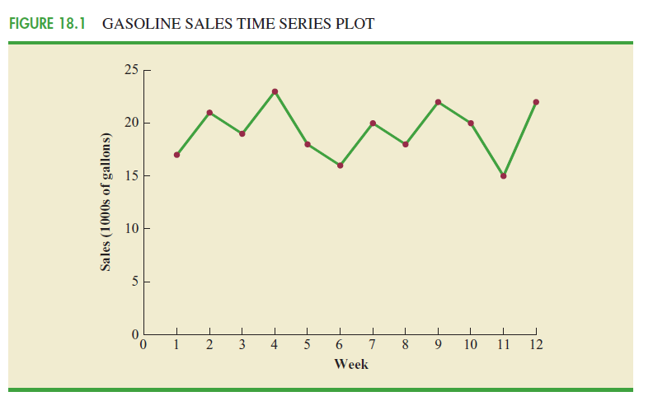
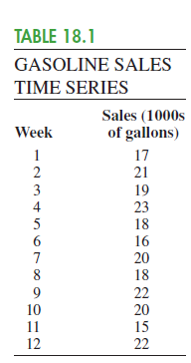
Horizontal Pattern

Slide 18
The term stationary time series is used to denote a time series whose statistical properties are independent of time.
In particular this means that
1. The process generating the data has a constant mean.
2. The variability of the time series is constant over time.

Slide 19
observing a horizontal pattern is not sufficient evidence to conclude that the time series is stationary

Slide 20
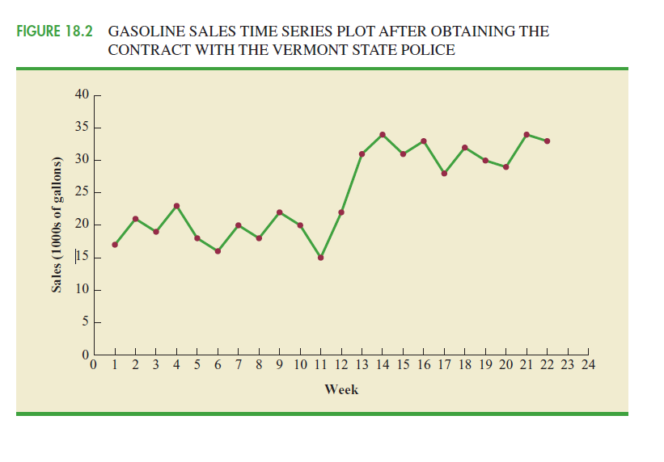

Slide 21
Trend Pattern
Seasonal Pattern
Cyclical Pattern

Slide 22
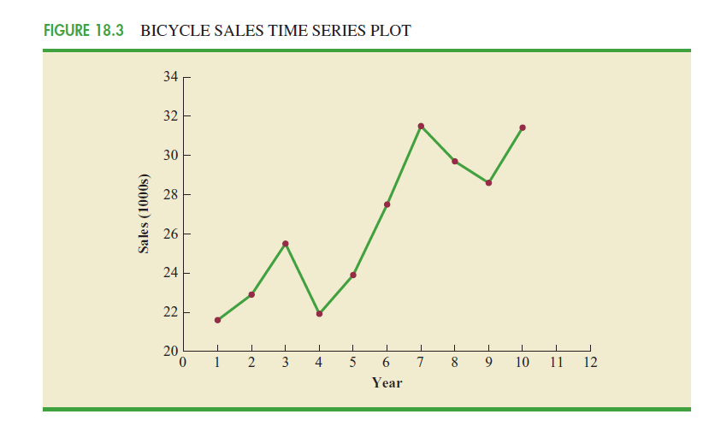
Seasonal !!

Slide 23
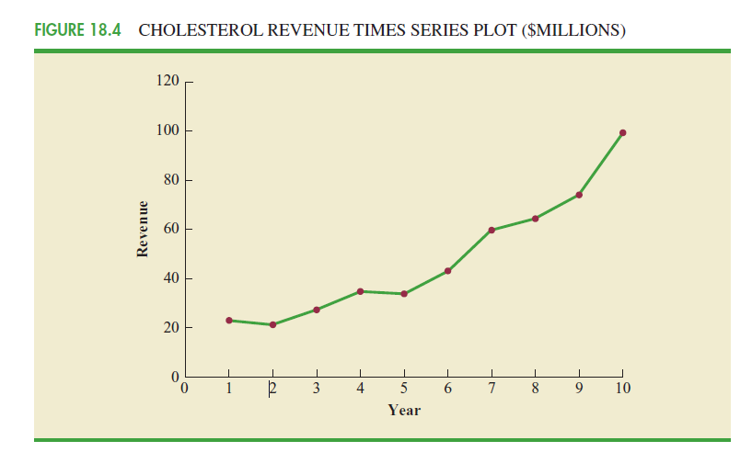

Slide 24
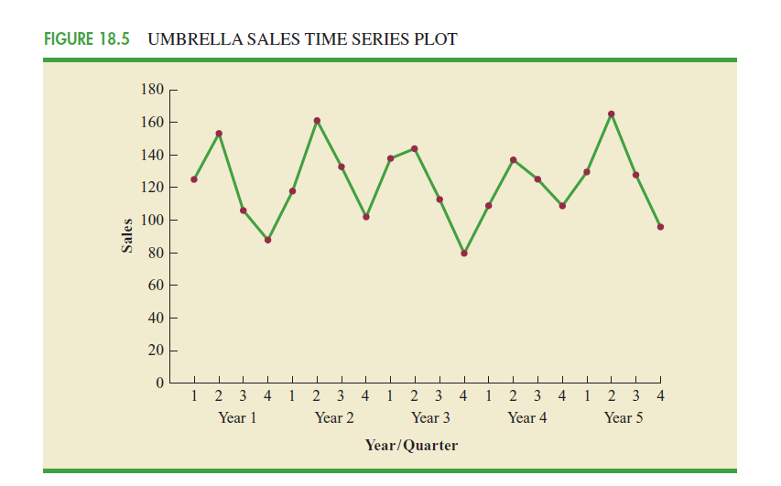
cyclical

Slide 25
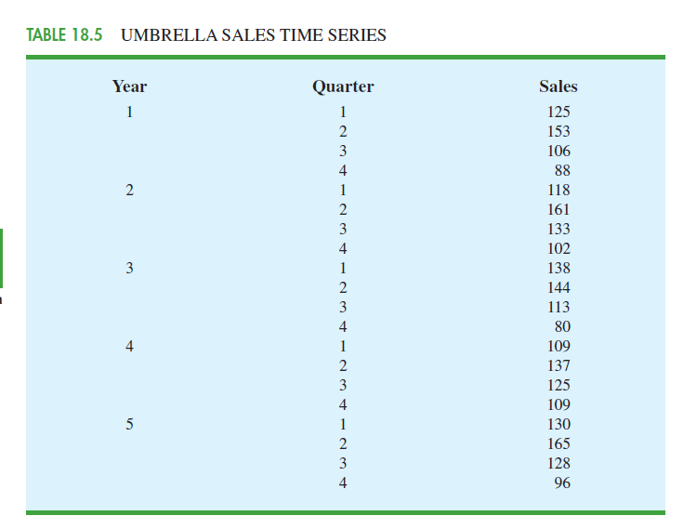

Slide 26
Selecting a Forecasting Method
Forecast Error = ActualValue - Forecast
Forecast Accuracy
An approach that uses the most recent week’s sales volume as the forecast for the next week (naïve forecasting method)

Slide 27
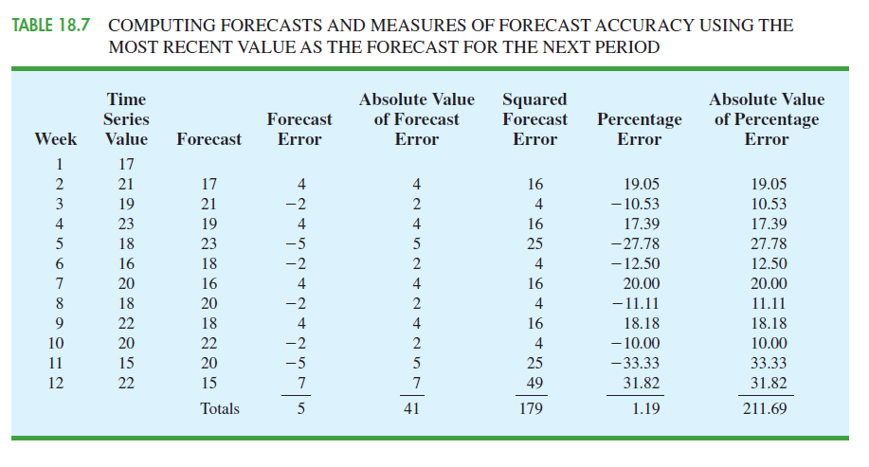

Slide 28
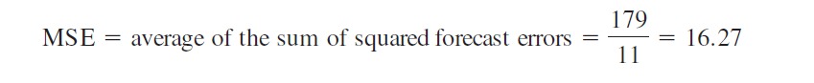
mean squared error,

Slide 29
Moving Averages and Exponential Smoothing
moving averages,
weighted moving averages,
Exponential smoothing

Slide 30
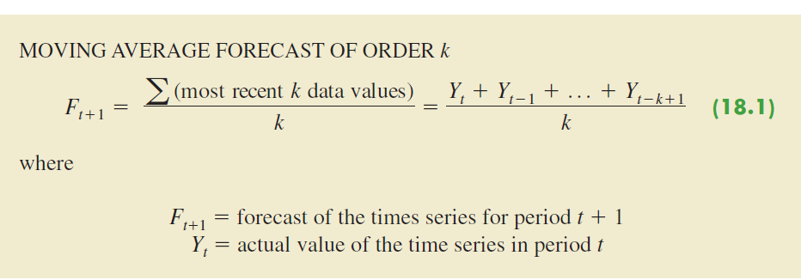
The moving averages method uses the average of the most recent k data values in the time series as the forecast for the next period

Slide 31
The term moving is used because every time a new observation becomes available for the time series, it replaces the oldest observation in the equation and a new average is computed. As a result, the average will change, or move, as new observations become available.

Slide 32
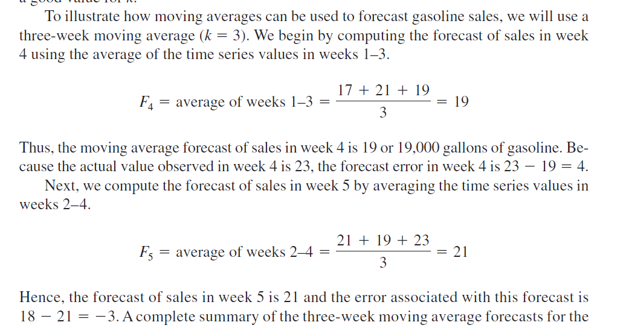

Slide 33
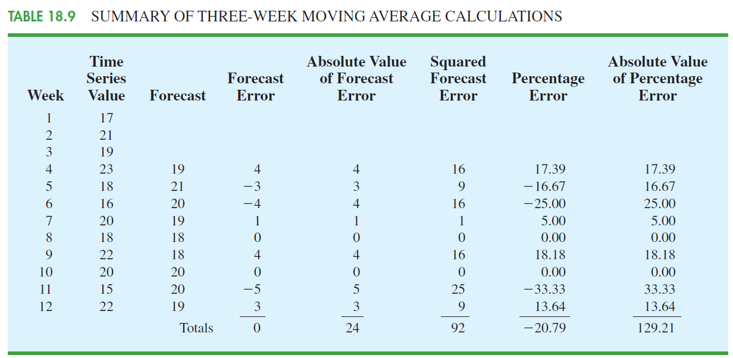

Slide 34
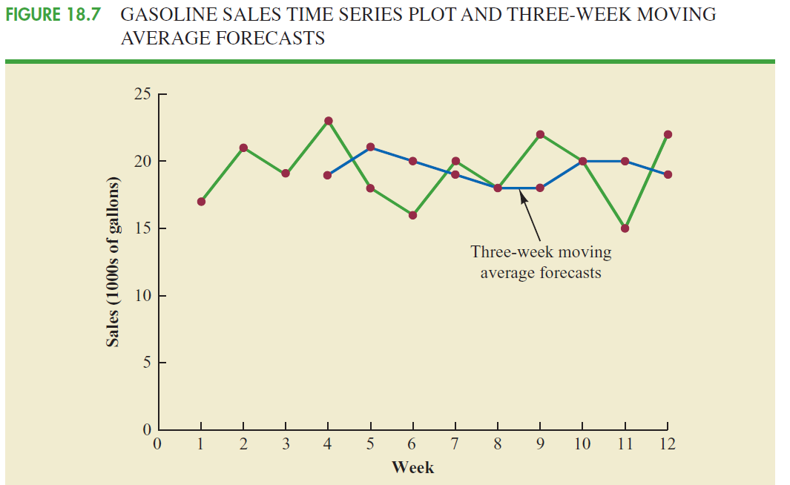

Slide 35
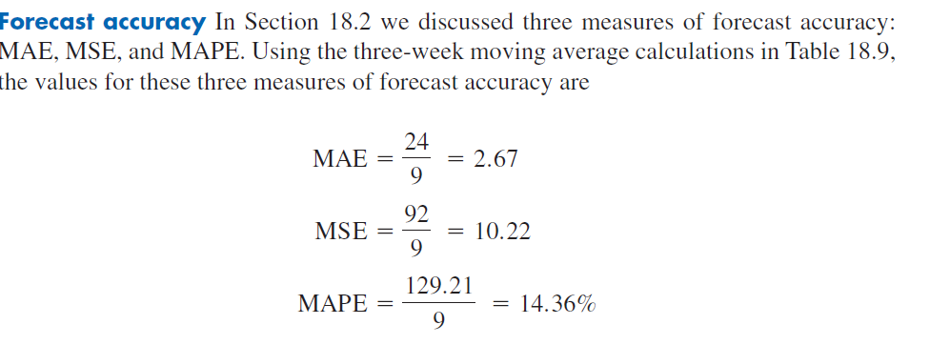

Slide 36
it can be shown that the minimum value of MSE corresponds to a moving average of order k 6 with MSE 6.79
a moving average of order k 6. is best

Slide 37
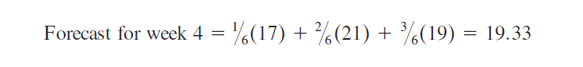
weighted moving averages,
One variation, known as weighted moving averages, involves selecting a different weight for each data value and then computing a weighted average of the most recent k values as the forecast.

Slide 38
Exponential smoothing
it is a special case of the weighted moving averages method in which we select only one weight—the weight for the most recent observation

Slide 39
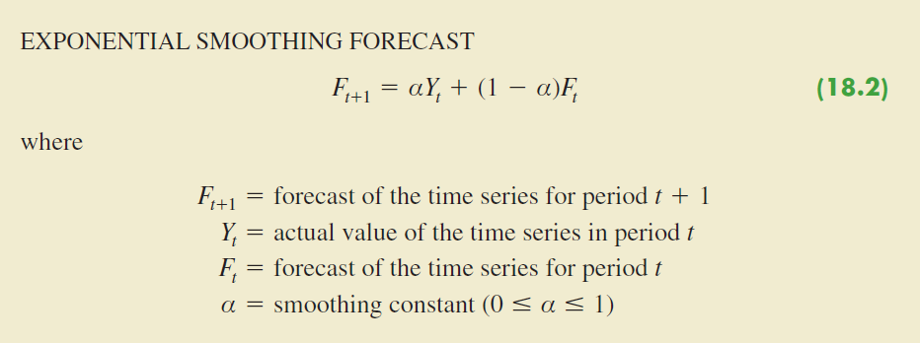

Slide 40
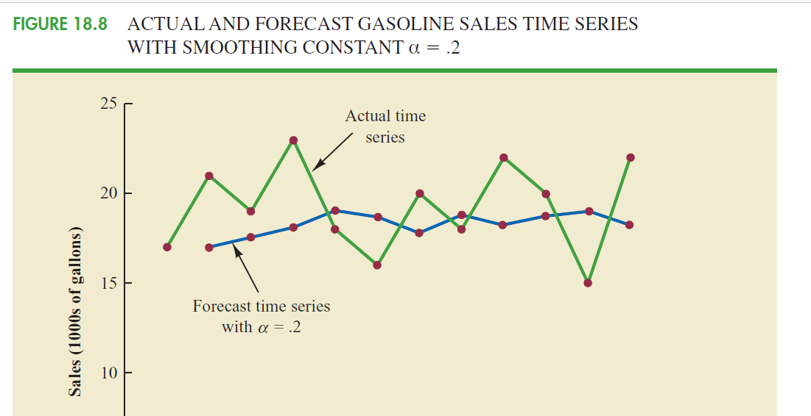

Slide 41
Trend Projection
simple linear regression
Holt’s linear exponential smoothing
curvilinear or nonlinear trend.

Slide 42
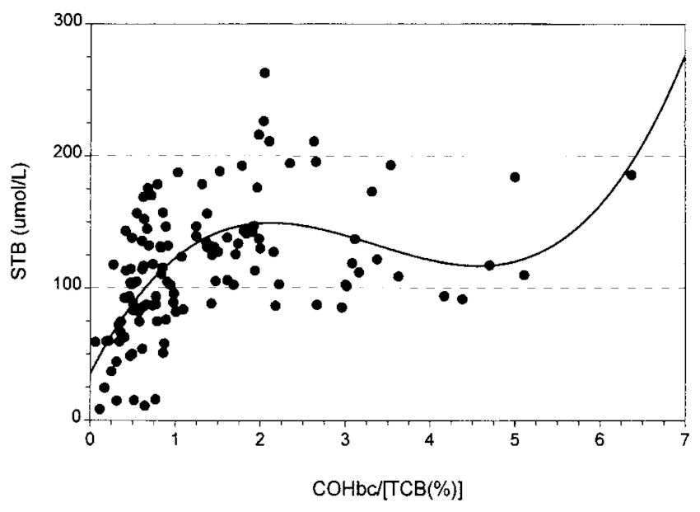
Curvilinear regression

Slide 43
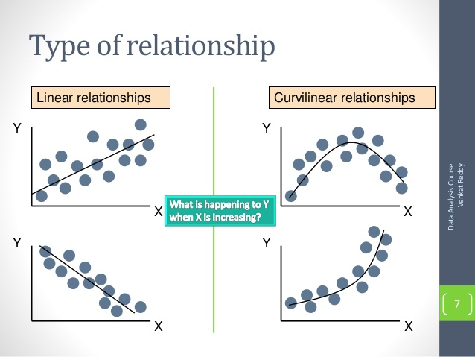
Curvilinear regression

Slide 44
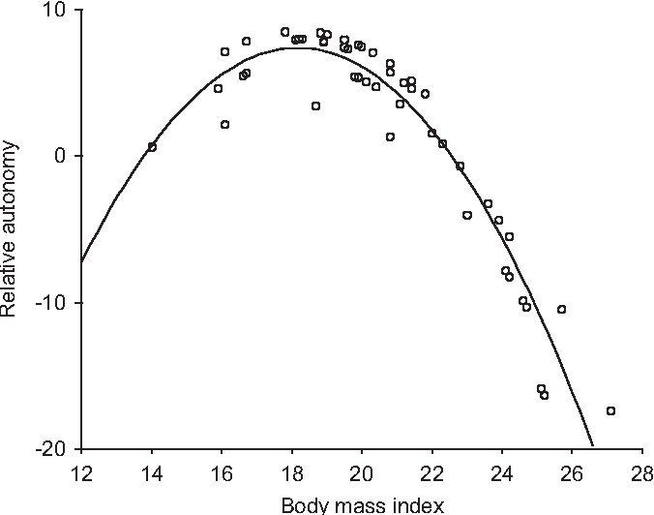

Slide 45
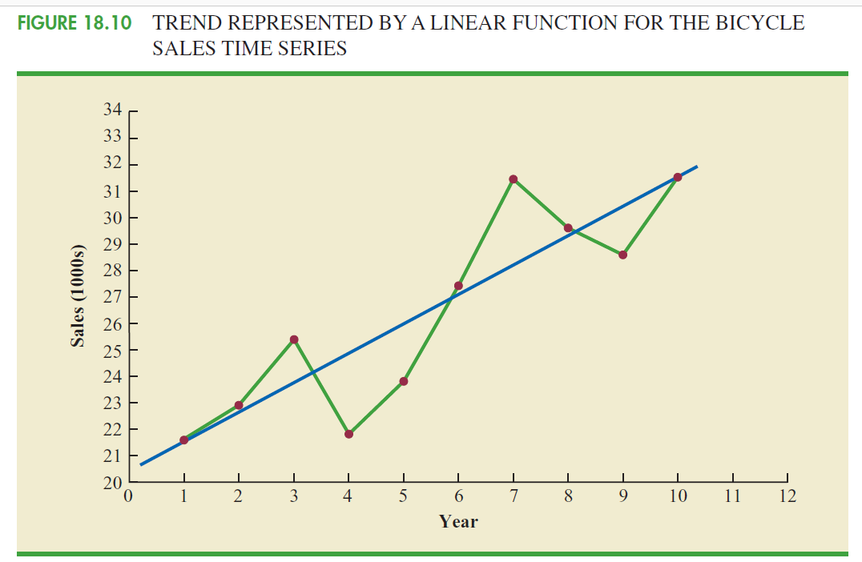

Slide 46
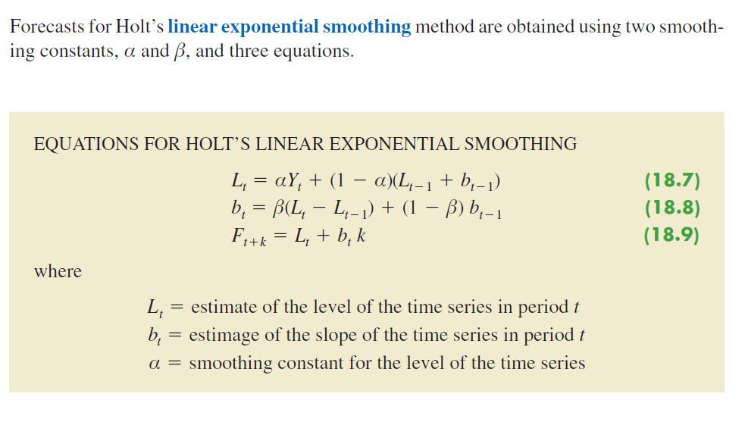
Holt’s Linear Exponential Smoothing

Slide 47
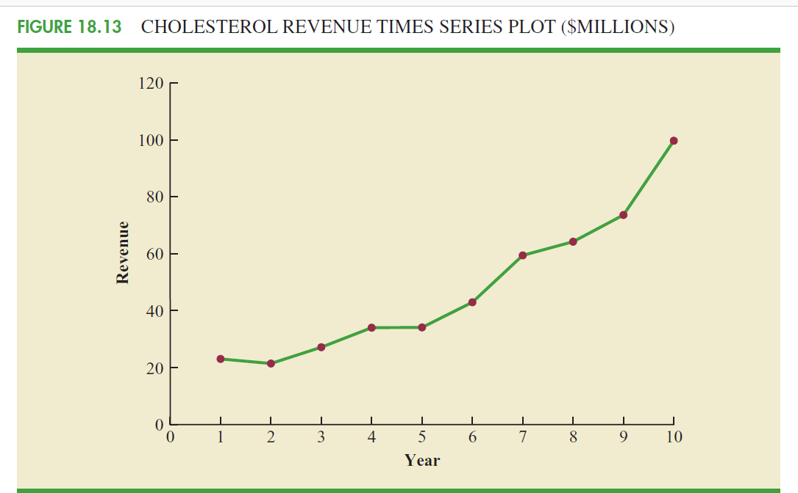
Nonlinear Trend Regression

Slide 48
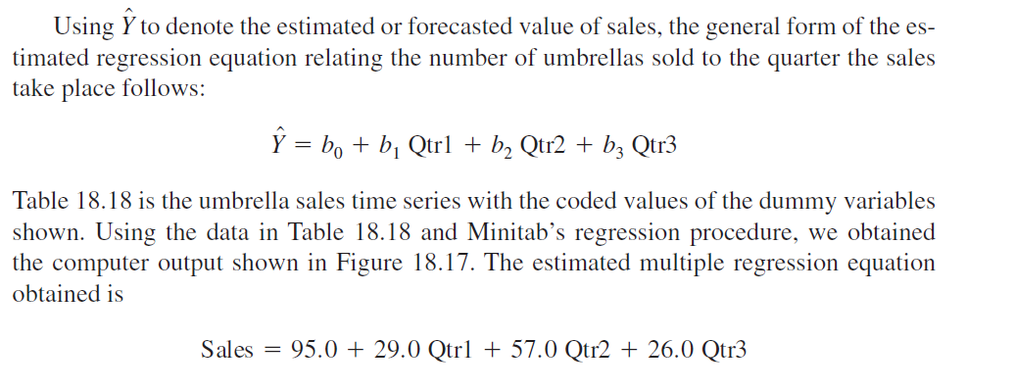
Seasonality and Trend
Seasonality Without Trend

Slide 49
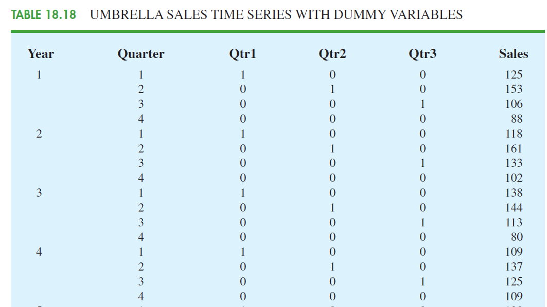
Dummy Variables

Slide 50
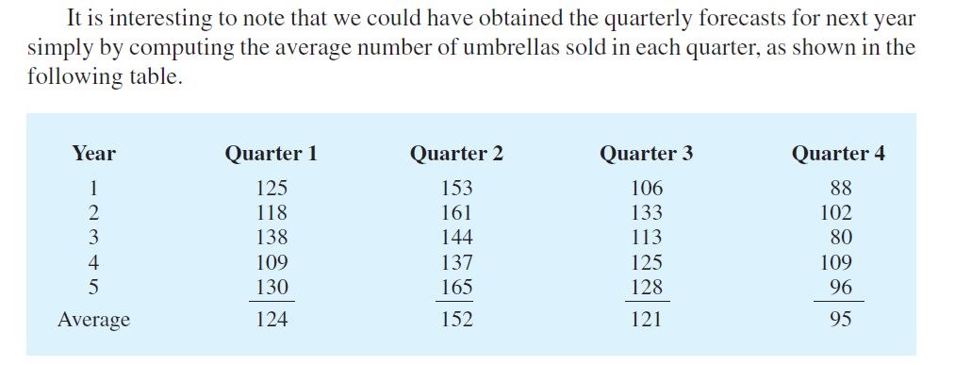

Slide 51
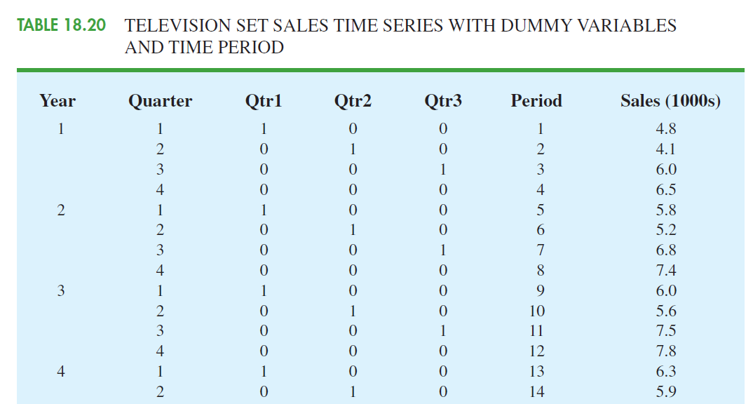
Seasonality and Trend

Slide 52
time series decomposition.
Time series decomposition can be used to separate or decompose a time series into
seasonal,
trend,
and irregular components.

Slide 53
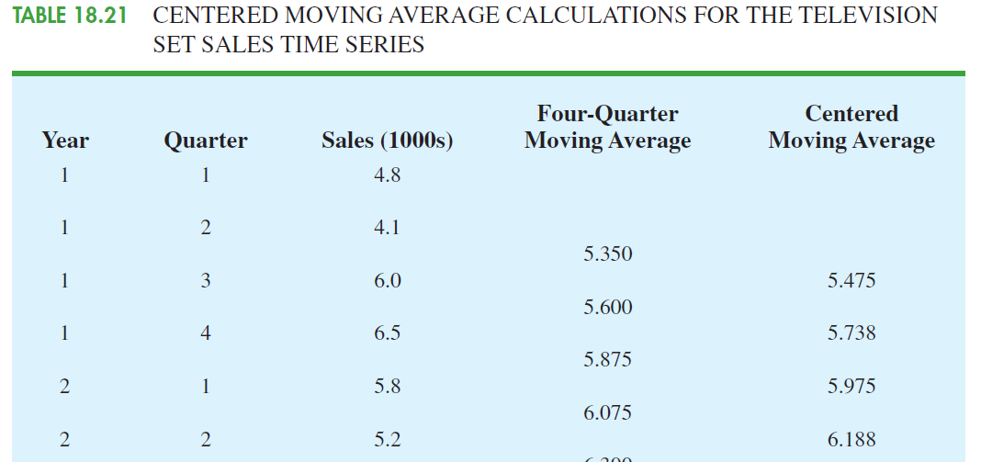

Slide 54
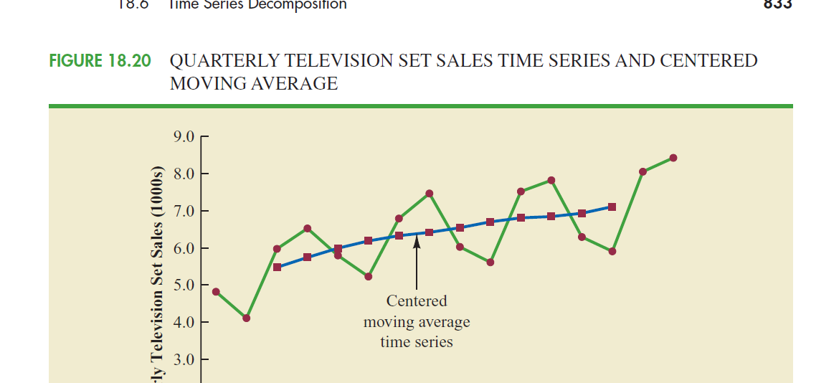

Slide 55
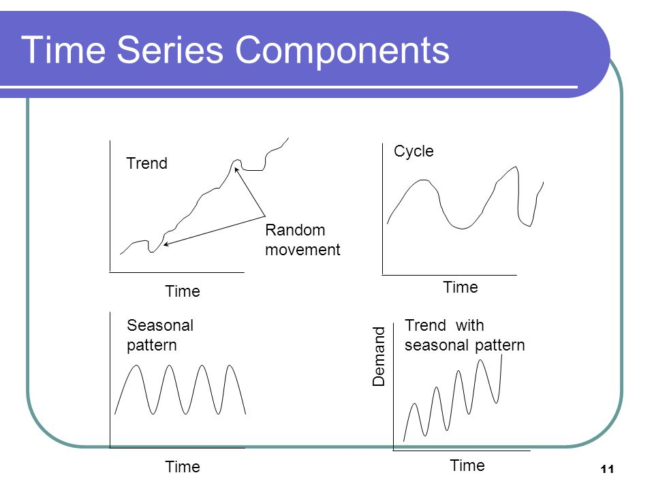

Slide 56
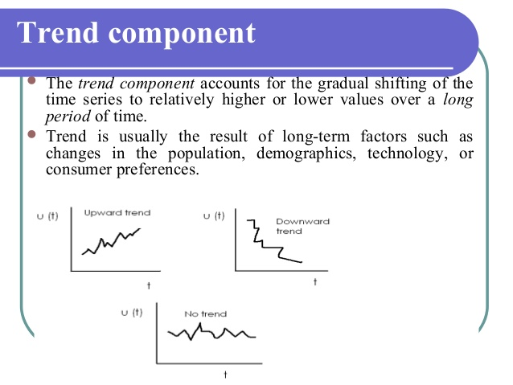

Slide 57
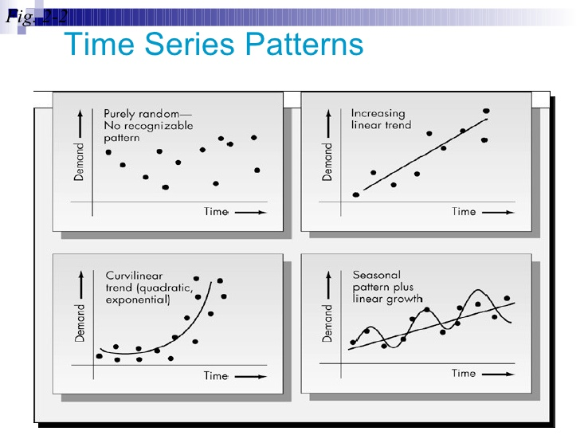

Slide 58
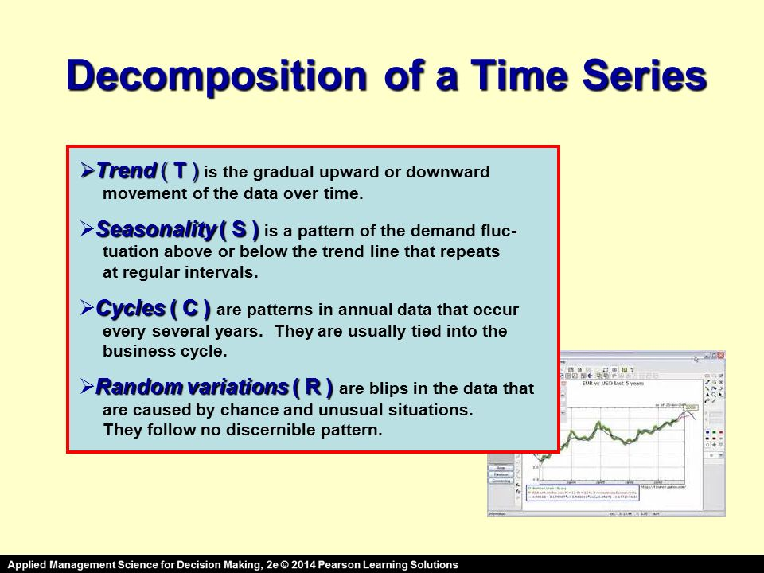

Slide 59
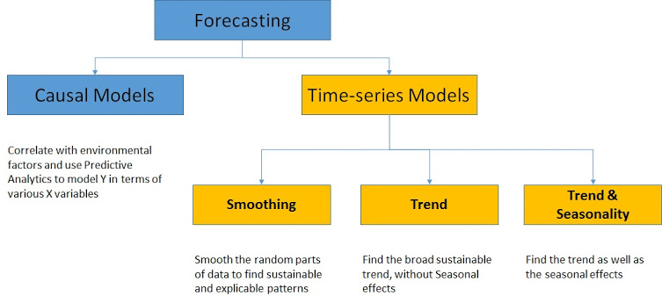

Slide 60
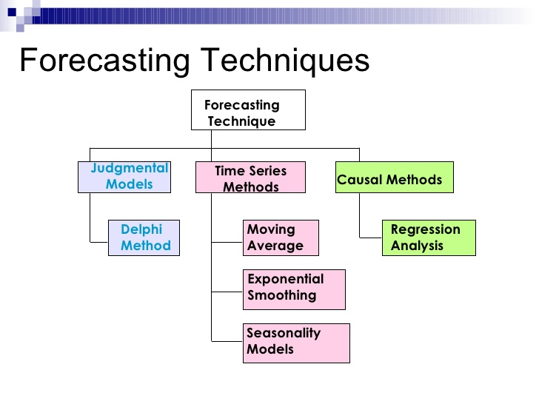

Slide 61
Mean absolute error (MAE) The average of the absolute values of the forecast errors.
Mean squared error (MSE) The average of the sum of squared forecast errors.
Mean absolute percentage error (MAPE) The average of the absolute values of the percentage forecast errors.

Slide 62
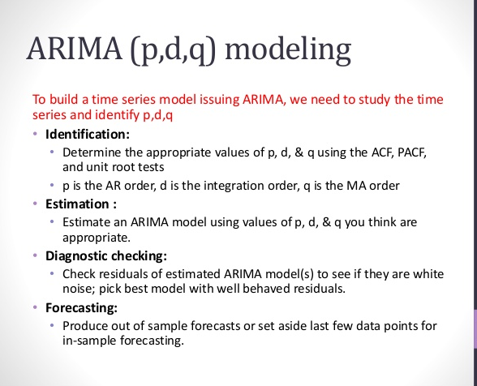
ARIMA

Slide 63
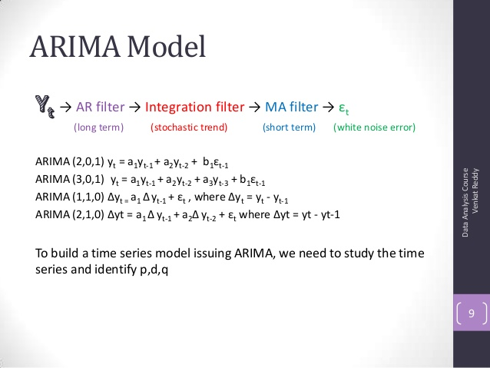

Slide 64
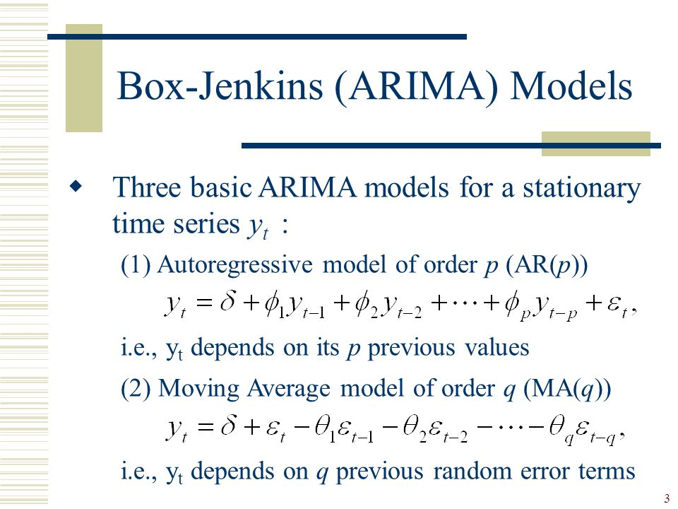

Slide 65
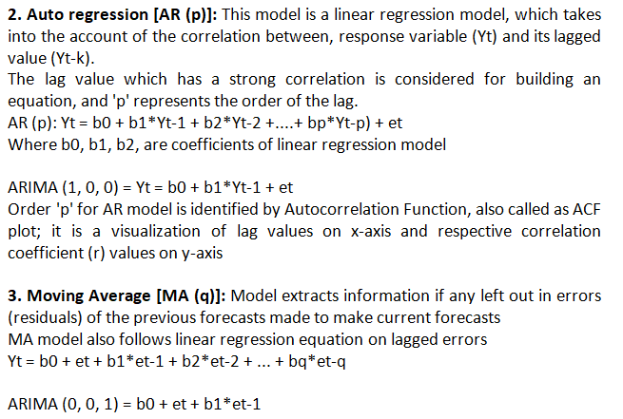

Slide 66
Partial autocorrelation function (PACF)
Finding appropriate values of p and q in the ARMA(p,q) model can be facilitated by plotting the
partial autocorrelation functions for an estimate of p,
and likewise using the autocorrelation functions for an estimate of q.

Slide 67
Differencing in statistics is a transformation applied to time-series data in order to make it stationary.
A stationary time series' properties do not depend on the time at which the series is observed.

Slide 68
AIC : Akaike information criterion (AIC)
Bayesian information criterion (BIC)

Slide 69
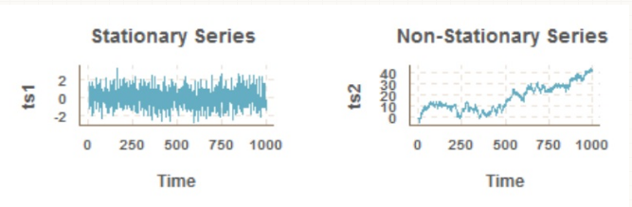

Slide 70
How to Check if Time Series Data is Stationary ?
The observations in a stationary time series are not dependent on time.
Time series are stationary if they do not have trend or seasonal effects. Summary statistics calculated on the time series are consistent over time, like the mean or the variance of the observations.

Slide 71
When a time series is stationary, it can be easier to model. Statistical modeling methods assume or require the time series to be stationary to be effective.

Slide 72
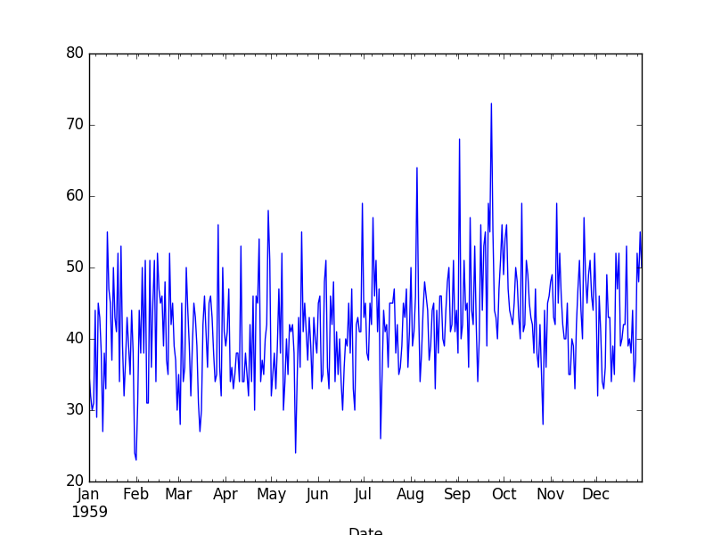

Slide 73
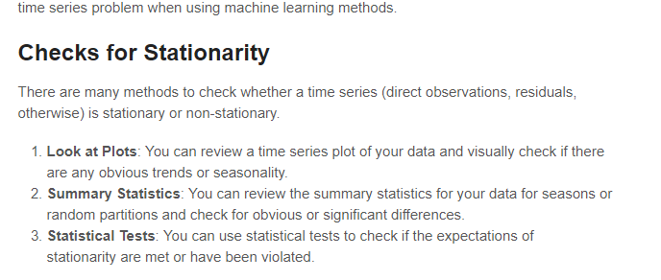

Slide 74
Augmented Dickey-Fuller test
ADF Statistic: -4.808291
p-value: 0.000052
Critical Values:
5%: -2.870
1%: -3.449
10%: -2.571

Slide 75
seasonality
In time series data, seasonality is the presence of variations that occur at specific regular intervals less than a year, such as weekly, monthly, or quarterly. Seasonality may be caused by various factors, such as weather, vacation, and holidays^{[1]} and consists of periodic, repetitive, and generally regular and predictable patterns in the levels^{[2]} of a time series.

Slide 76
Seasonal fluctuations in a time series can be contrasted with cyclical patterns
The latter occur when the data exhibits rises and falls that are not of a fixed period.

Slide 77
These fluctuations are usually due to economic conditions and are often related to the "business cycle".
The period of time usually extends beyond a single year and the fluctuations are usually of at least two years

Slide 78
autocorrelation plot
For seasonality

